Slide 2
Unit 4: Discrete System (7 hrs)
4.1 Introduction To Discrete System
4.2 Components Of The Discrete System
4.3 Representation Of Time
4.4 Examples For Discrete System
4.4.1 Telephone Call System As Lost Call And Delayed Call System
4.4.2 Bank Queue System
4.5 Simulation Programming Task
4.6 Steps Of Simulation Programming Task
4.7 Gathering Statistics
4.7.1 Counters And Summary Measures
4.7.2 Measuring Utilization And Occupancy
4.7.3 Recording Distribution And Summary Measures
4.8 Discrete System Simulation Languages

Slide 3
Discrete System
The system in which changes are discontinuous is called a discrete system.
Each change in the state of a system is called an event.
For example, the arrival or departure of a customer in a queue is an event.
Similarly, sales of an item from stock are an event in the inventory system.

Slide 4
Discrete System
Discrete event simulation concerns the modelling of the system as it evolves over time by a representation in which state variable changes instantaneously or separate point in time.
Therefore, the discrete system is often called a discrete system simulation.

Slide 5
Component | Description
Entities | The objects/items being processed or tracked. Example: Customers, packets, orders.
Attributes | Characteristics or properties of an entity. Example: Arrival time, service time, priority.
Events | Instantaneous occurrences that change the system’s state. Example: Arrival, departure, machine failure.
State Variables | Describe the system at any point in time. Example: Number of entities in queue, status of server.
Resources | Elements used by entities during the simulation. Example: Servers, machines, cashiers.
Queues | Waiting lines where entities wait for resource availability.
Activities | Time-consuming operations performed by the system. Example: Service time, processing time.
Delay | Time an entity spends waiting in the system (in queue or activity).
Clock | Keeps track of simulated time as the system advances from one event to another.
Statistical Counters | Collect and store system performance metrics (e.g., average queue length, server utilization).

Slide 6
Representation of Time
It refers to a number that records the passage of time.
It is usually set to zero at the beginning of a simulation.
And, subsequently, indicates how many units of simulated time have passed since the beginning of the simulation.

Slide 7
Representation of Time
Absolute Time: The actual simulation clock time at which an event occurs. Example: 10:00 AM, 45.5 seconds
Relative Time: Time interval between two events. Example: 5 seconds between arrival and service start
Wall-clock Time: Real-world time taken by the simulation to execute (not usually important in logic, but relevant for performance). Example: Simulation completes in 2 minutes of real time.
Simulation Time: Artificial time used in the simulation, which advances as events occur. Example: Event 1 at t = 5, Event 2 at t = 10

Slide 8
Representation of Time
Simulation Time:
It refers to the integrated clock time.
Note that it is not the time that a computer has taken to carry out the simulation.
The ratio of simulated time to the real-time taken can vary to a great extent depending on the following factors:
Nature of the system being simulated.
The detail to which it is modelled.

Slide 9
Representation of Time
Simulation Time:
Example:
The simulation of an atomic model.
Changes occur in a fraction of a microsecond in a real system.
However, the simulation of these atomic models in a computer may take 1000 time more time than in the actual system.

Slide 10
Representation of Time
Updating Clock Time:
There are two basic methods used to update clock time:
Event Oriented Method [Next Time Advance Mechanism]
The clock is advanced to the time at which the next event is due to occur.
Usually carried out in Discrete System Simulation.
Interval Oriented Method [Fixed Time Advance Mechanism]
The clock is advanced by a small and usually uniform interval of time.
Usually carried out in Continuous System Simulation.

Slide 11
Representation of Time
An interval-oriented program will detect discrete changes and can therefore simulate a discrete system.
An event-oriented program can be made to follow continuous changes by artificially introducing events that occur at a regular time interval and can therefore simulate a continuous system.

Slide 12
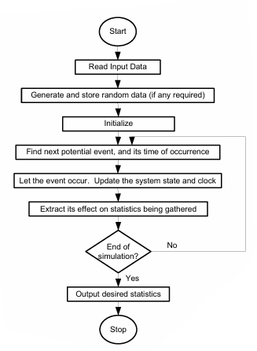
Event Oriented Method

Slide 13
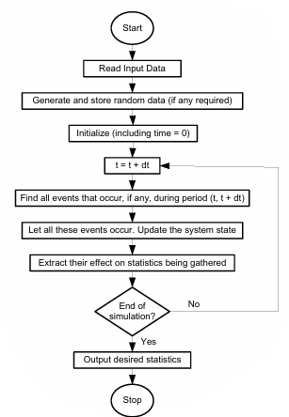
Interval Oriented Method

Slide 14
Significant Event Simulation
It is another method to represent the passage of time and is applicable to continuous system in which there is quiescent (continuous) period.
A quiescent period is the interval between events in the event-oriented approach, but it involves the model's representation of the system activities which create a notice of the event that terminates the interval.
The significant event approach assumes that simple analytic function can be used to project the value of a quiescent period.

Slide 15
Significant Event Simulation
For example, an automobile travelling at constant acceleration, it movement might result in a significant event for several reasons:
It might reach at the end the road.
It’s velocity must reach some limit.
It might come to rest.
If the initial conditions are known, the elapsed time for each these possible events can be calculated from a simple formula.

Slide 16
Generation of Arrival Patterns
Arrival pattern for particular system must be specified for simulation.
The generation of exogenous arrival is an important aspect of discrete system simulation.
Trace Driven Simulation
Bootstrapping

Slide 17
Trace Driven Simulation
It refers to the process of gathering a sequence of inputs based on the observation of a real system.
When there is no interaction between exogenous arrivals and the endogenous events of a system, it is permissible to create a sequence of arrival in preparation for the simulation.
Usually, the simulation proceeds by creating new arrivals as they are needed.

Slide 18
Bootstrapping
Bootstrapping usually refers to a self-starting process that is supposed to proceed without external input.
It is the process of making one entity creates its successor.
These methods require keeping only the arrival time of the next entity, it is therefore the preferred method of generating arrivals for computer simulation programs.

Slide 19
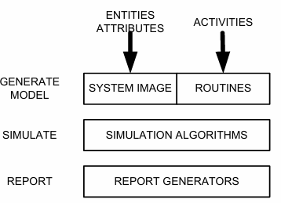
Simulation Programming Task
There are mainly three tasks to be performed in simulation programming. They are:
Generating a model
Simulation
Generating Report

Slide 20
Simulation Programming Task
Generating a Model:
The first task in simulation programming is to generate and initialize a model.
In this state, a set of several most created to represent the state of the system.
Thus, this set of numbers is called the system image.
The activities that occur in the system are in routines.

Slide 21
Simulation Programming Task
Simulation:
After generating a model, the next step is to program the procedure that executes the cycle of actions involved in carrying out the simulation.
This procedure is referred to as a simulation algorithm.

Slide 22
Simulation Programming Task
Generating Report:
After programming the simulation algorithm, the next and final task is to run the simulation to generate an output report.
The statistic gather (data collected) during the simulation will be organized by a report generator.

Slide 23
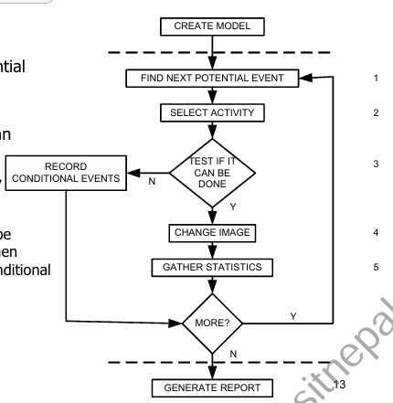
Simulation Algorithm Steps
Find the next potential event
Select an activity
Test if the event can be executed
If direct measure, either success or abandon
If the event can be executed later, then it is known as conditional event
Change the system image
Gather statistics

Slide 24
Simulation Algorithm Steps
The general flow of control during the execution of the simulation program is shown above.
At the top of the figure is the task of generating a model which is executed once.
At the bottom is the report generation task, which is usually executed once at the end of the simulation.
Carrying out the simulation algorithm involves repeated execution of given five steps.

Slide 25
End of Lecture 11

Slide 26
Telephone Call System

